Slide 1

WEEK 10-11
CESAR A. PASCAL VASQUEZ

Slide 2
Viam is a robotics software platform designed to streamline the development and operation of hardware systems. It serves as an intermediary framework that connects physical components, such as sensors and actuators, with high-level software, including artificial intelligence models. By providing standardized commands, Viam eliminates the need for custom, hardware-specific programming. Additionally, it features integrated cloud capabilities for remote data monitoring and system control.

Slide 3
  The Hosting: GitHub Pages only serves static files, so the entire simulation must run locally inside the visitor's web browser. There is no backend server.
  The Physics (MuJoCo Wasm): You use WebAssembly (Wasm) to run the MuJoCo engine directly in the browser. This handles gravity, collisions, and drawing the 3D G1 robot.
  The Brain (ONNX Runtime Web): Python AI models won't run in a browser. Users must convert their trained policies into a web-friendly format called ONNX. Your site runs this file to calculate the robot's next move.
  The Bridge (JavaScript): Your code connects the two. It reads the G1's current balance from MuJoCo, feeds it to the ONNX brain, gets the motor commands back, and tells MuJoCo to apply that force.
  Viam's Role: Because everything runs client-side, Viam acts purely as a cloud data logger to record the robot's joint telemetry (like angles and torques) to track why a policy worked or failed.

Slide 4
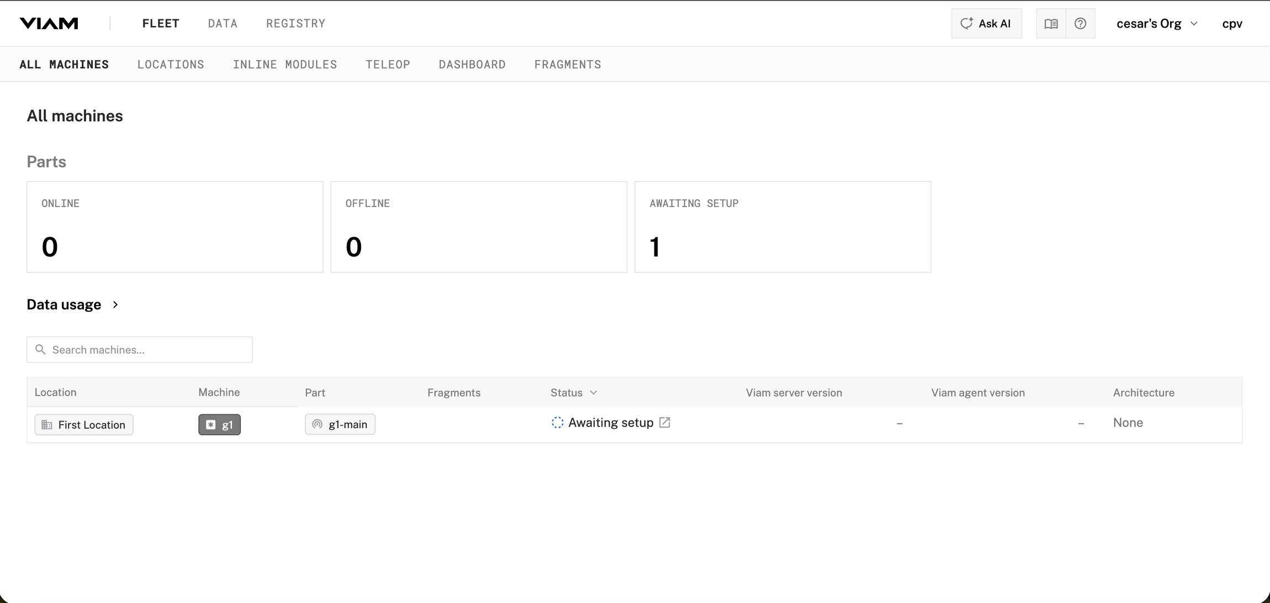

Slide 5
Rerun is a high-performance visualization toolbox designed to help understand complex data over time. While Viam focuses on the control and data routing of the robot, Rerun is used to see exactly what is happening inside the robot's "brain" and its environment.

Slide 6
Visualizing Hidden States
When running a trained policy to make the G1 stand, we aren't just looking at the 3D model. we need to see the internal data, such as:
  Joint Torques: Are the motors hitting their limits?
  Center of Mass: Is the balance point staying within the footprint?
  Sensor Inputs: Is the noise from the filter scaling correctly before reaching the policy? Rerun allows you to plot these data streams in real-time alongside the 3D simulation.
Time-Travel Debugging
Rerun’s core feature is a "blueprint" timeline. If the G1 falls over at step 400, you can scrub the timeline back to step 390 to see the exact moment a specific joint failed or a sensor reading spiked. This is much faster than re-running the entire simulation to catch a glitch.

Slide 7
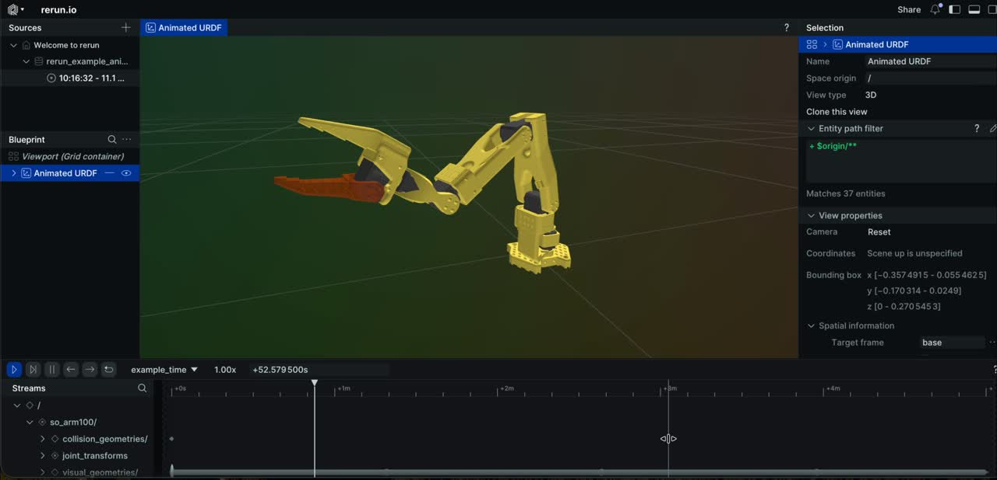

Slide 8
Integrating Rerun.io and Viam provides a dual-purpose architecture for the browser-based simulation. Rerun.io embeds a real-time dashboard alongside the MuJoCo environment, enabling immediate, in-browser visual debugging of policy metrics such as joint torques and balance. Concurrently, Viam operates in the background to log this telemetry to the cloud. This configuration delivers robust client-side visualization for the end-user while establishing a centralized pipeline for aggregating and analyzing performance data across all tested policies.

Slide 9
On a hard-coded function, I tried implementing different movement patterns such as waving, squatting, and walking. However, because the motions are hard-coded, it is more difficult to make complex actions like walking or squatting work properly and smoothly.
These movements require balance, timing, and feedback from the robot’s body position. A simple hard-coded animation can move the joints, but it does not fully understand when the robot is falling or how to correct its posture. Because of that, walking and squatting are harder to achieve without a trained controller or stabilizer.

Slide 10
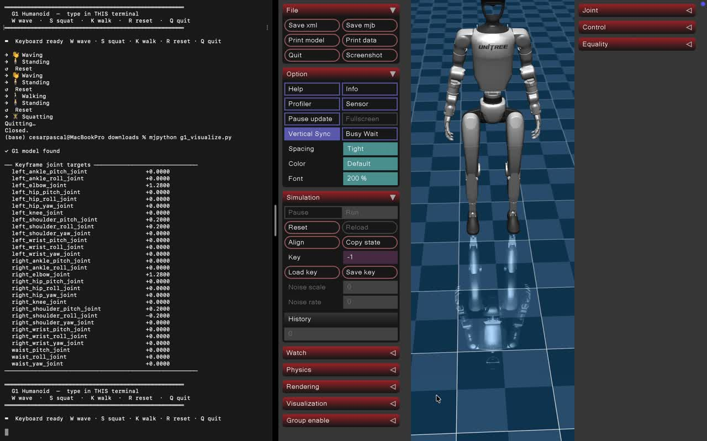

Slide 11
The stabilizer function is essentially there to keep the robot upright while the animation runs. In MuJoCo, humanoid robots like the G1 have a floating base, meaning the body can freely fall, tilt, or rotate if the forces aren’t balanced. Since your walking and squatting motions are scripted (not learned from a controller), they don’t naturally maintain balance. The stabilizer steps in by correcting the robot’s base position and orientation—typically keeping its height steady and its torso upright—so the robot doesn’t collapse while performing the motion.

Slide 12
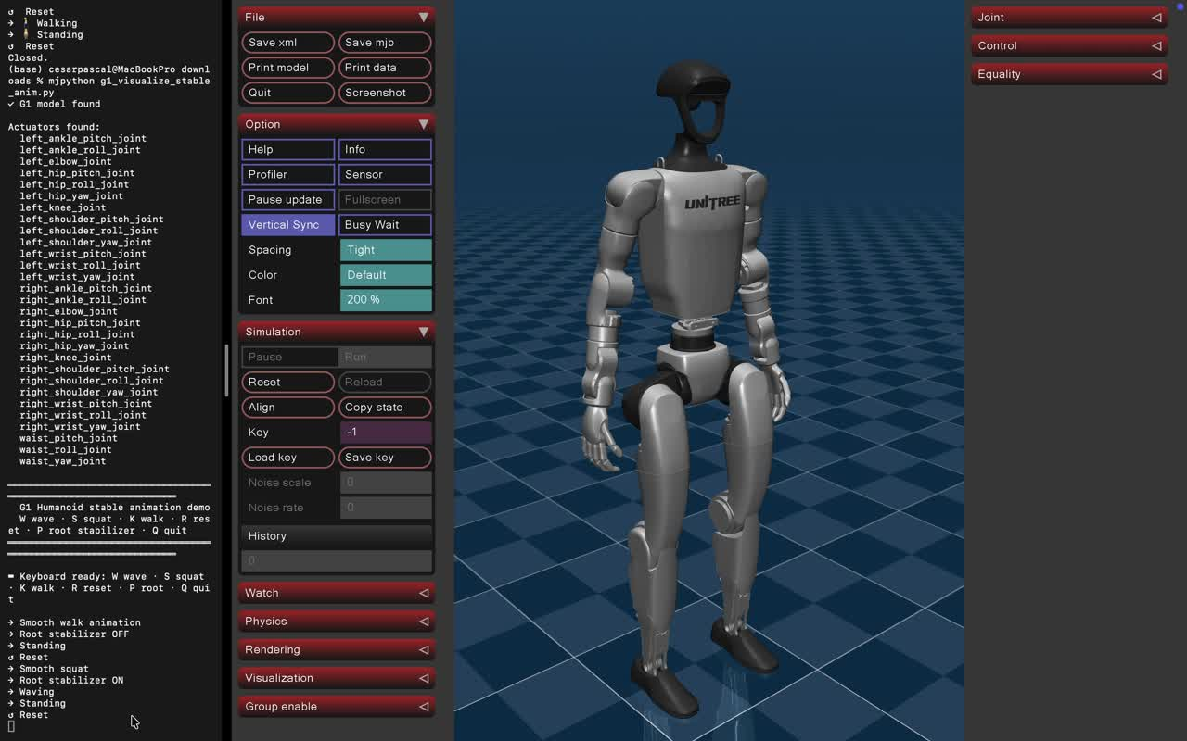

Slide 13
References
  DeepMind. (2026). MuJoCo: Advanced physics simulation. Retrieved from https://mujoco.org/
  Linux Foundation. (2026). ONNX Runtime Web. Retrieved from https://onnxruntime.ai/
  Rerun. (2026). Rerun: The data platform for physical AI. Retrieved from https://rerun.io/
  Viam, Inc. (2026). Viam: Robotics software platform. Retrieved from https://www.viam.com/

